Slide 1


Airbnb
By,
Evan T Gardner, Albert Burd, Corie Beale, Daniel P McLean, Renee Reyes

Slide 2
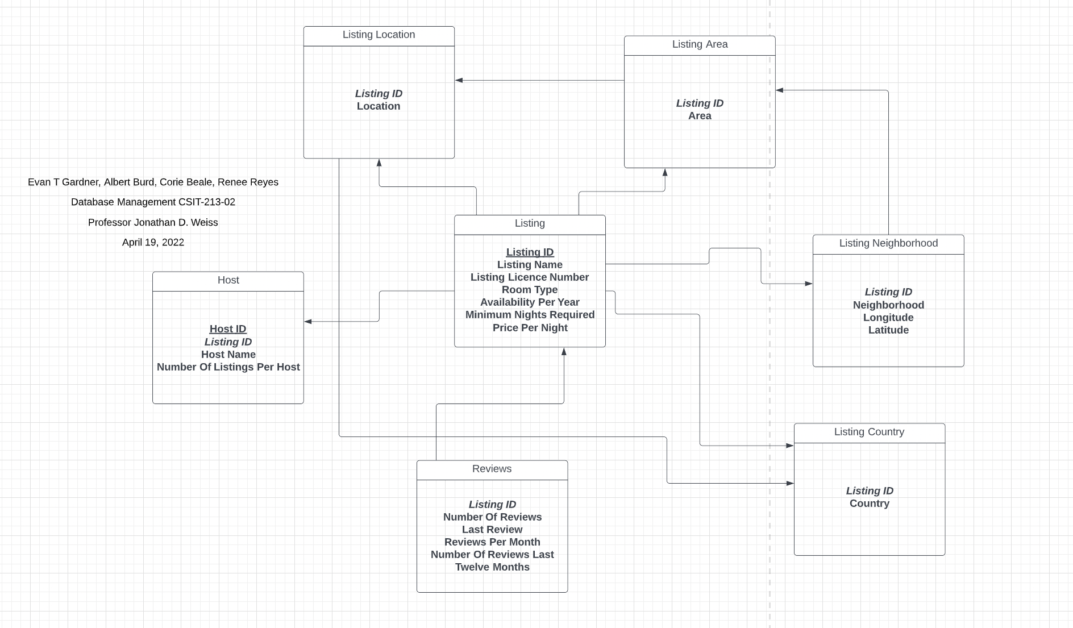
E-R Diagram

Slide 3
Logical Schema
Listing (Listing_ID, Listing_Name, Listing_Licence_Number, Room_Type, Availability_Per_Year, Minimum_Nights_Required, Price_Per_Night)
Listing_Country (Listing_ID, Country)
Listing_location (Listing_ID, Location)
Listing_Area (Listing_ID, Area)
Listing_Neighborhood (Listing_ID, Neighborhood, Longitude, Latitude)
Host (Host_ID, Listing_ID, Host_Name, Number_Of_Listings_Per_Host)
Reviews (Listing_ID, Number_Of_Reviews, Last_Review, Number_Of_Reviews_Per_Month, Number_Of_Reviews_Last_Twelve_Months)

Slide 4
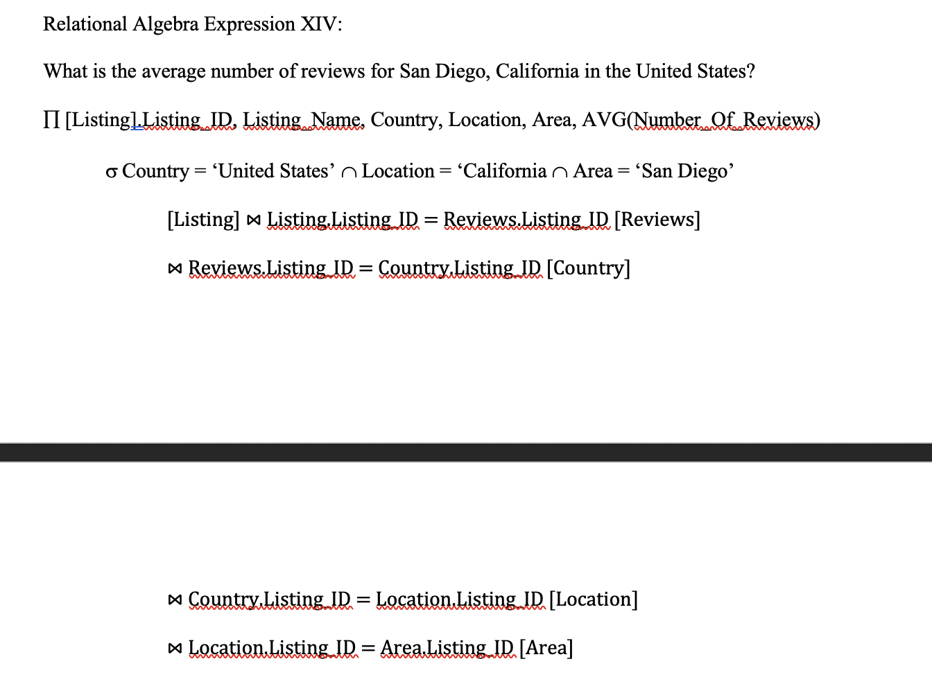
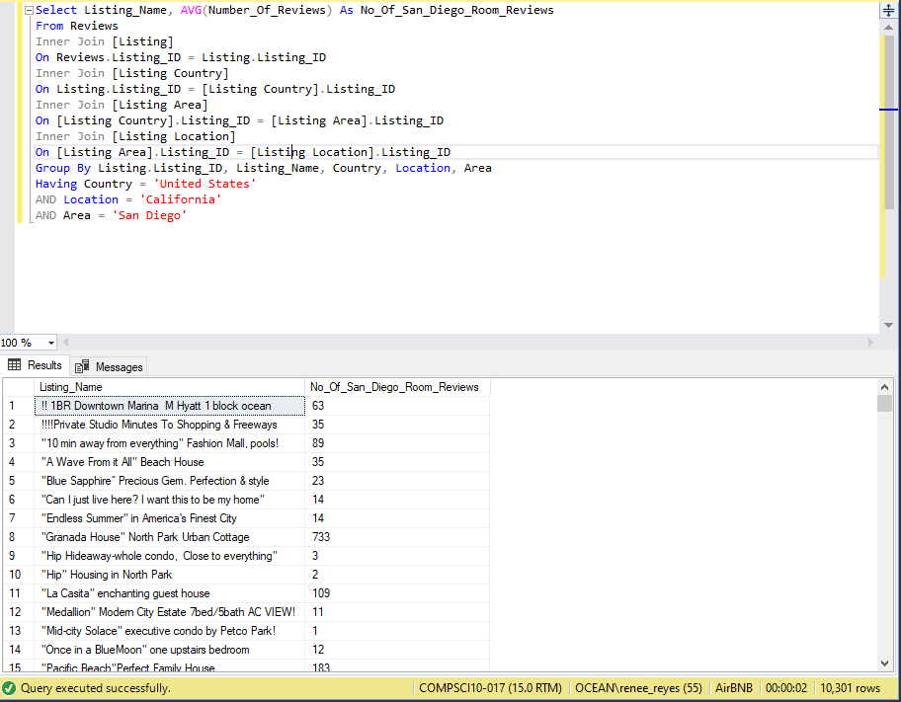
Query 1: What is the average number of reviews for San Diego, California in the United States?

Slide 5
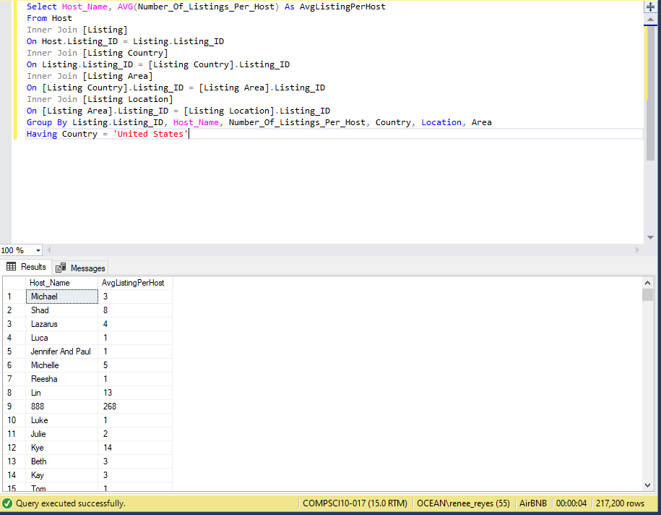
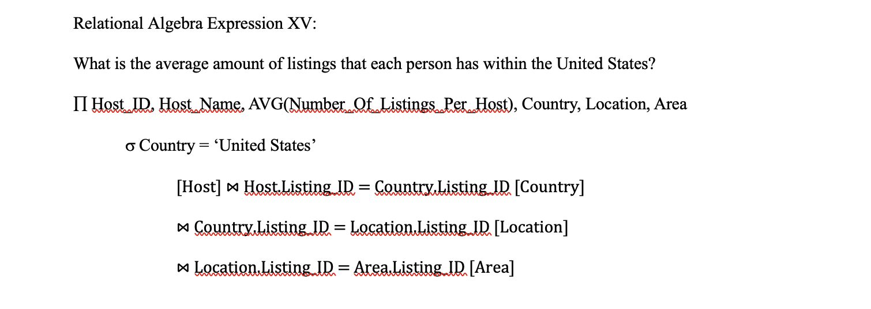
Query 2: What is the average amount of listings that each person has within the United States?

Slide 6
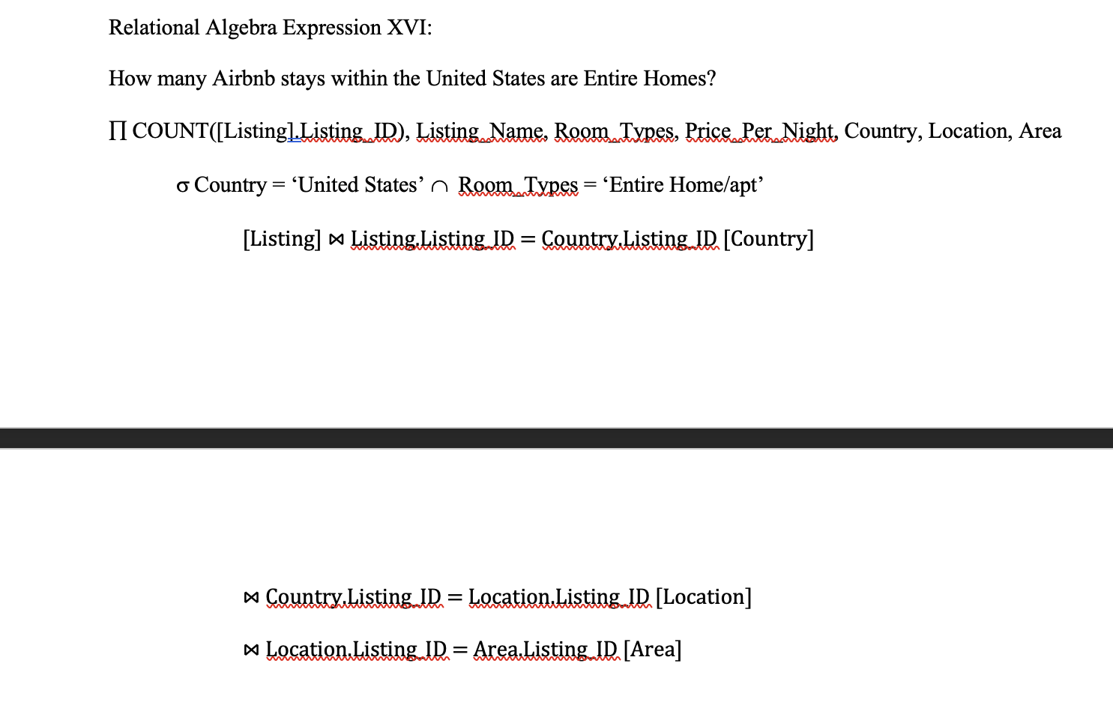
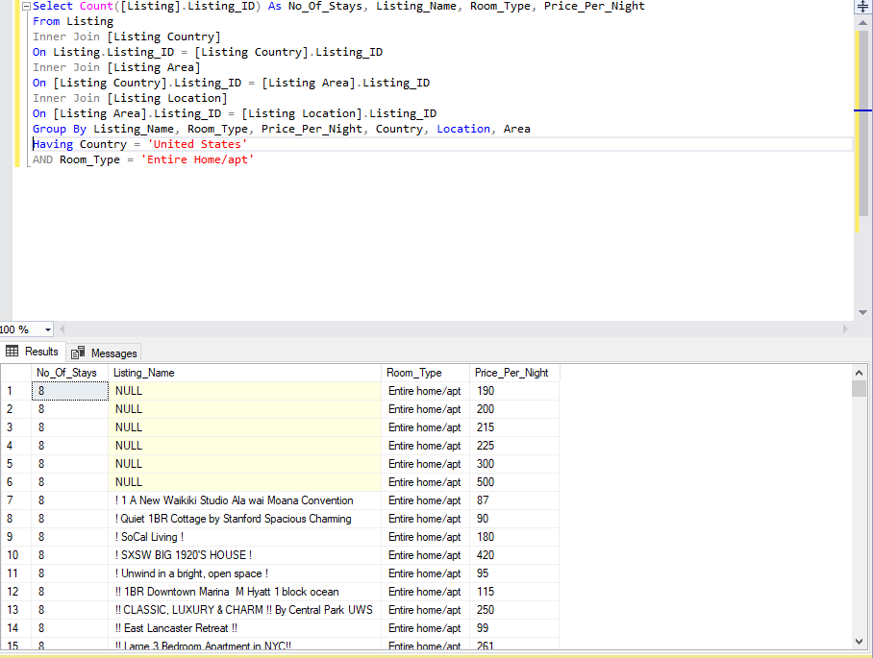
Query 3: How many Airbnb stays within the United States are Entire Homes?

Slide 7
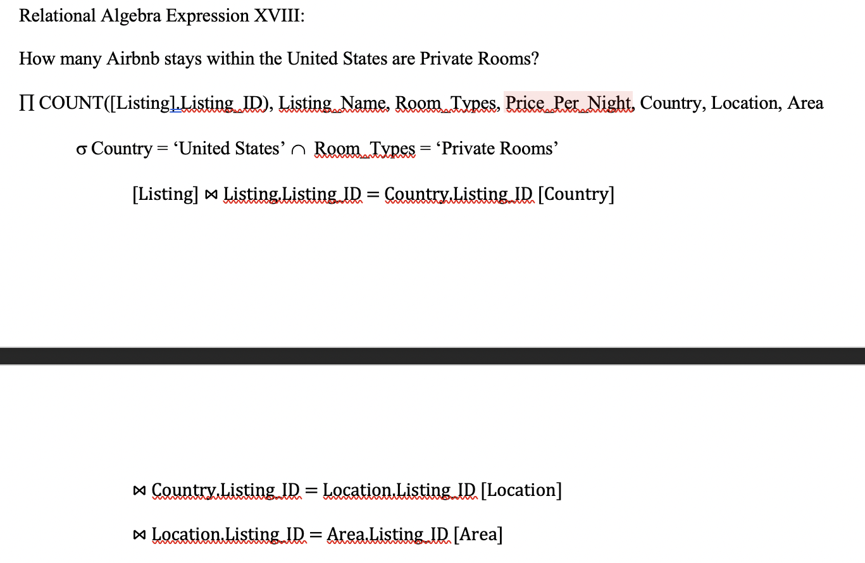
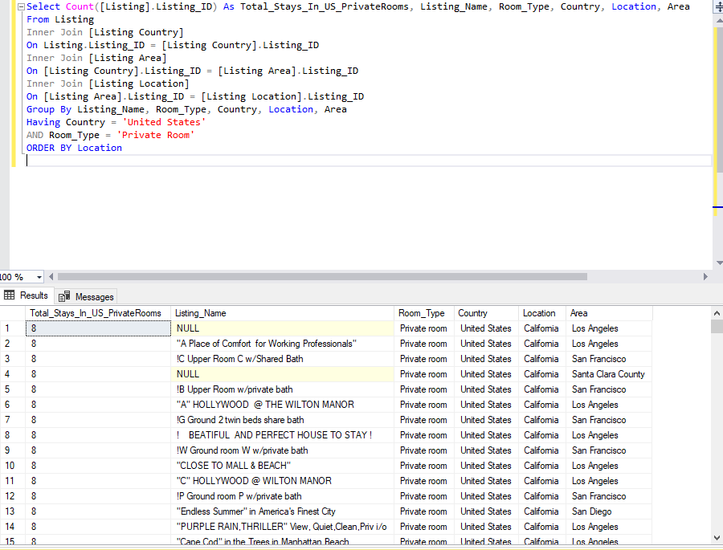
Query 4: How many Airbnb stays within the United States are Private Rooms?

Slide 8
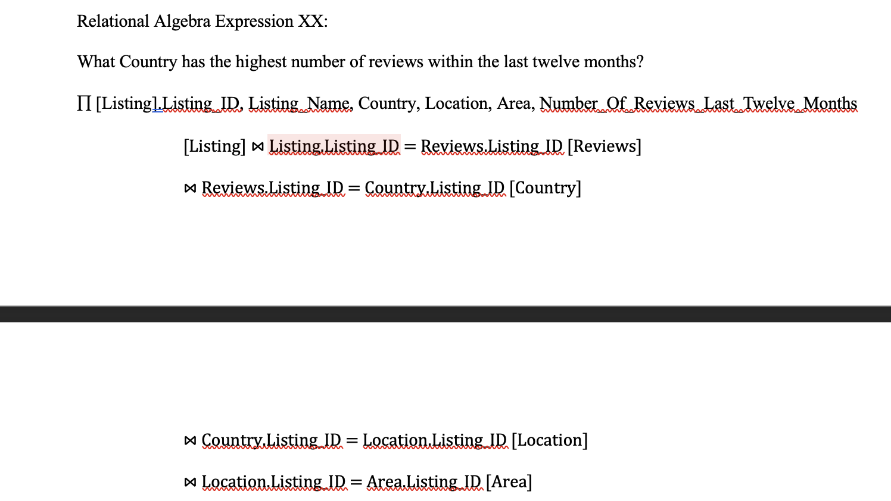
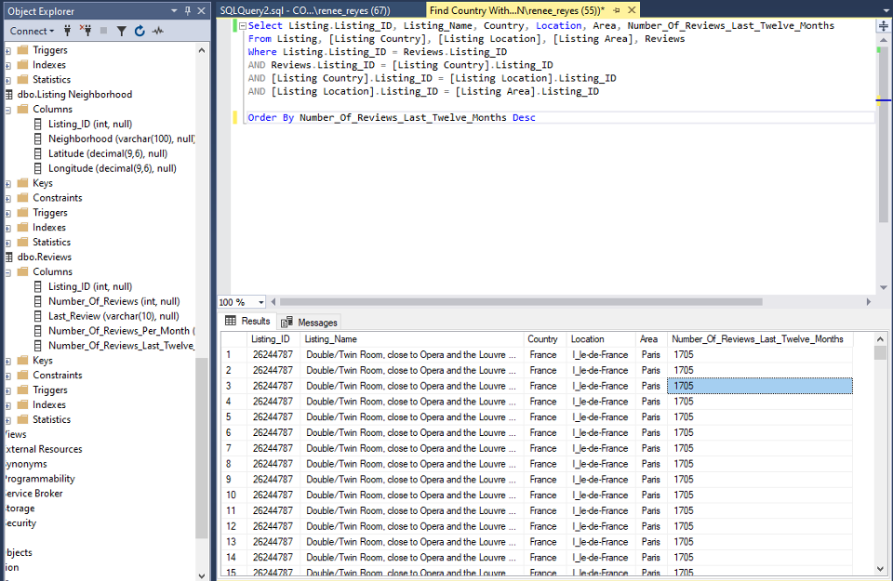
Query 5: What Country has the highest number of reviews within the last twelve months?

Slide 9
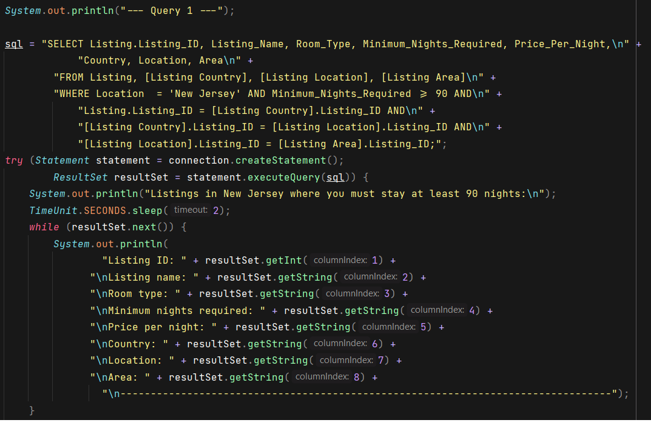
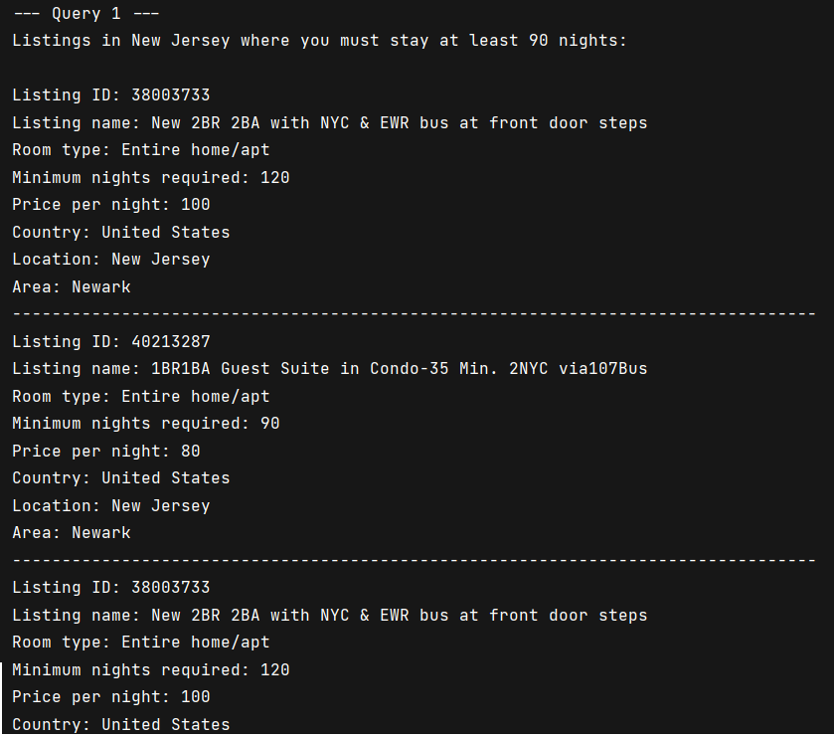
JDBC 1:

Slide 10
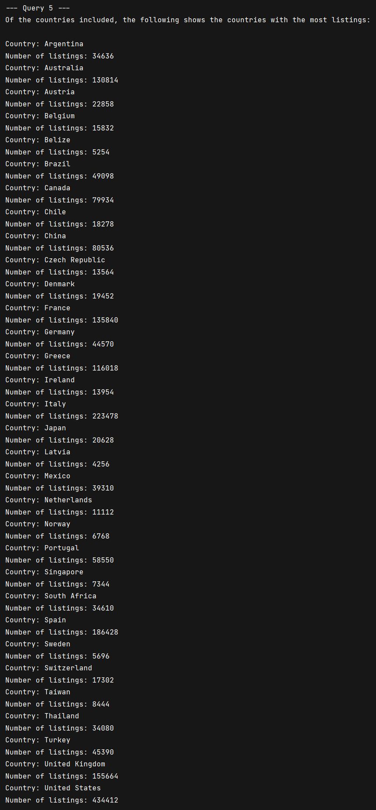
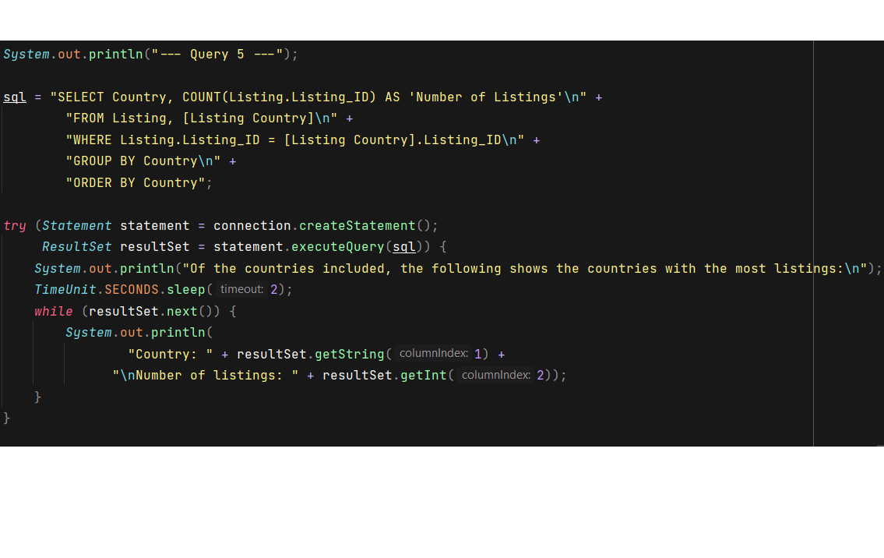
JDBC: 2

